Slide 1

Big Data & Business Intelligence
Irene Jacob

Slide 2

WHAT IS BIG DATA?

Slide 3
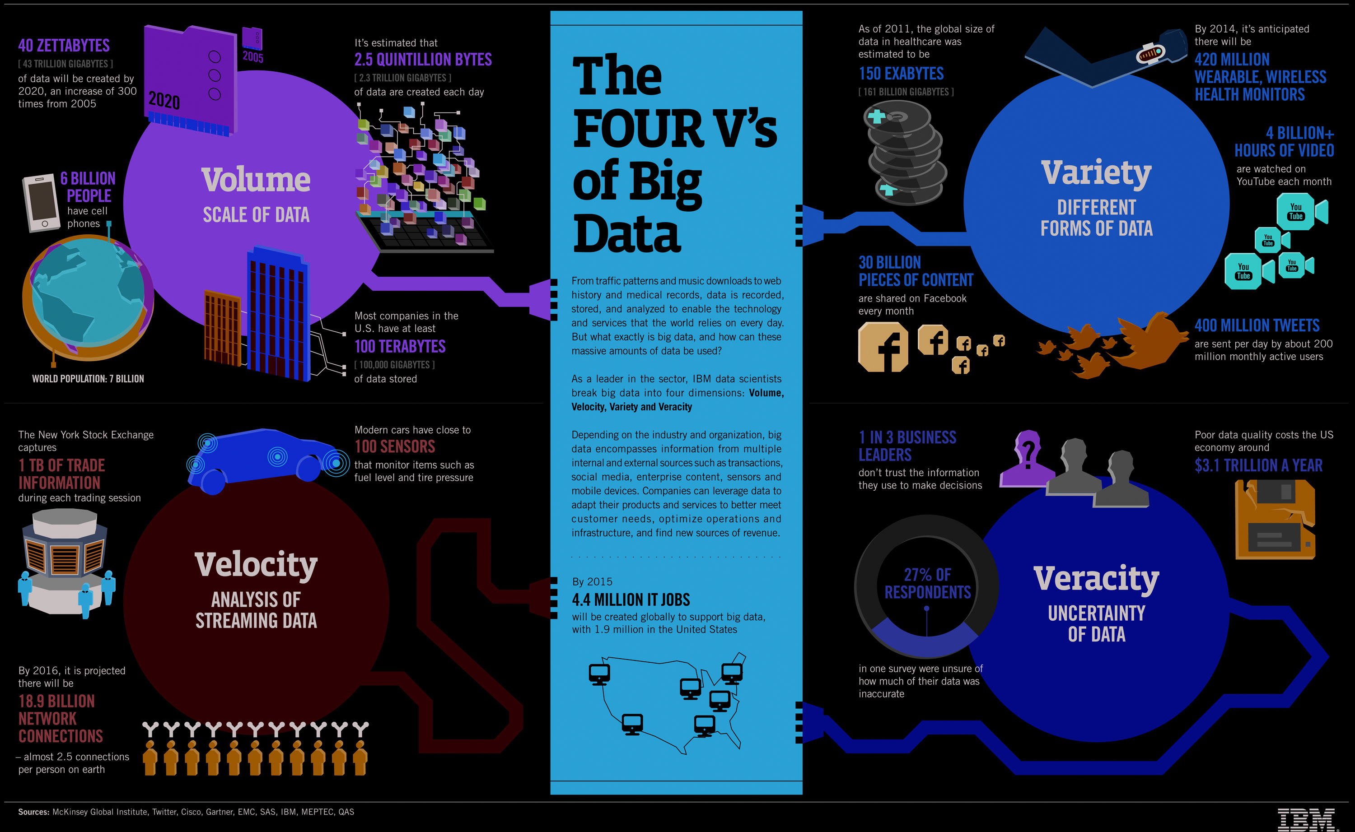

Slide 4
WHAT IS BUSINESS INTELLIGENCE?

Slide 5

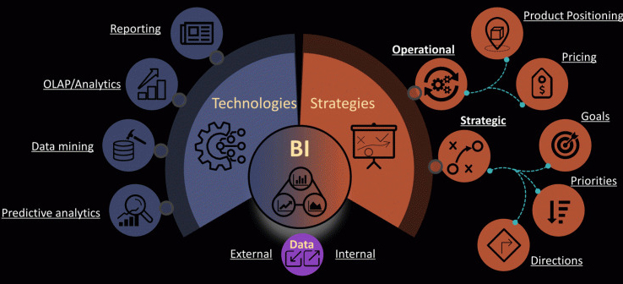
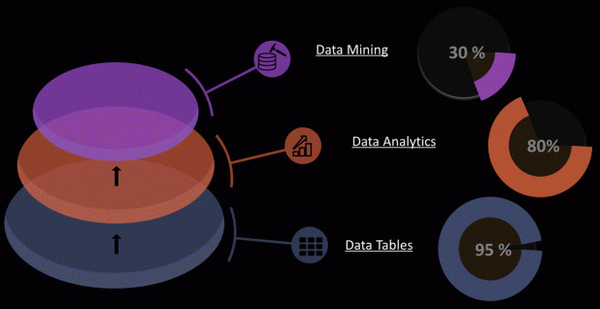
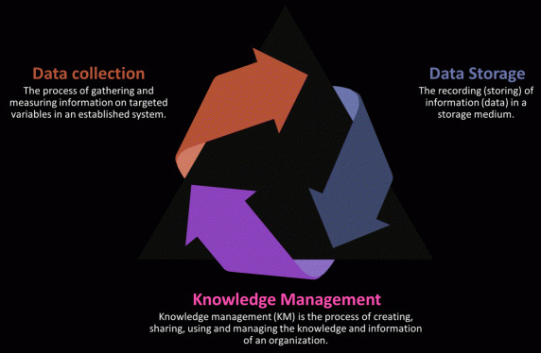
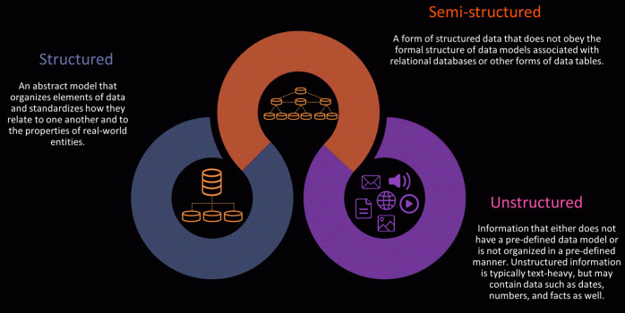
Hierarchy
Definition
Data categories

Slide 6
BIG DATA vs BUSINESS INTELLIGENCE

Slide 7
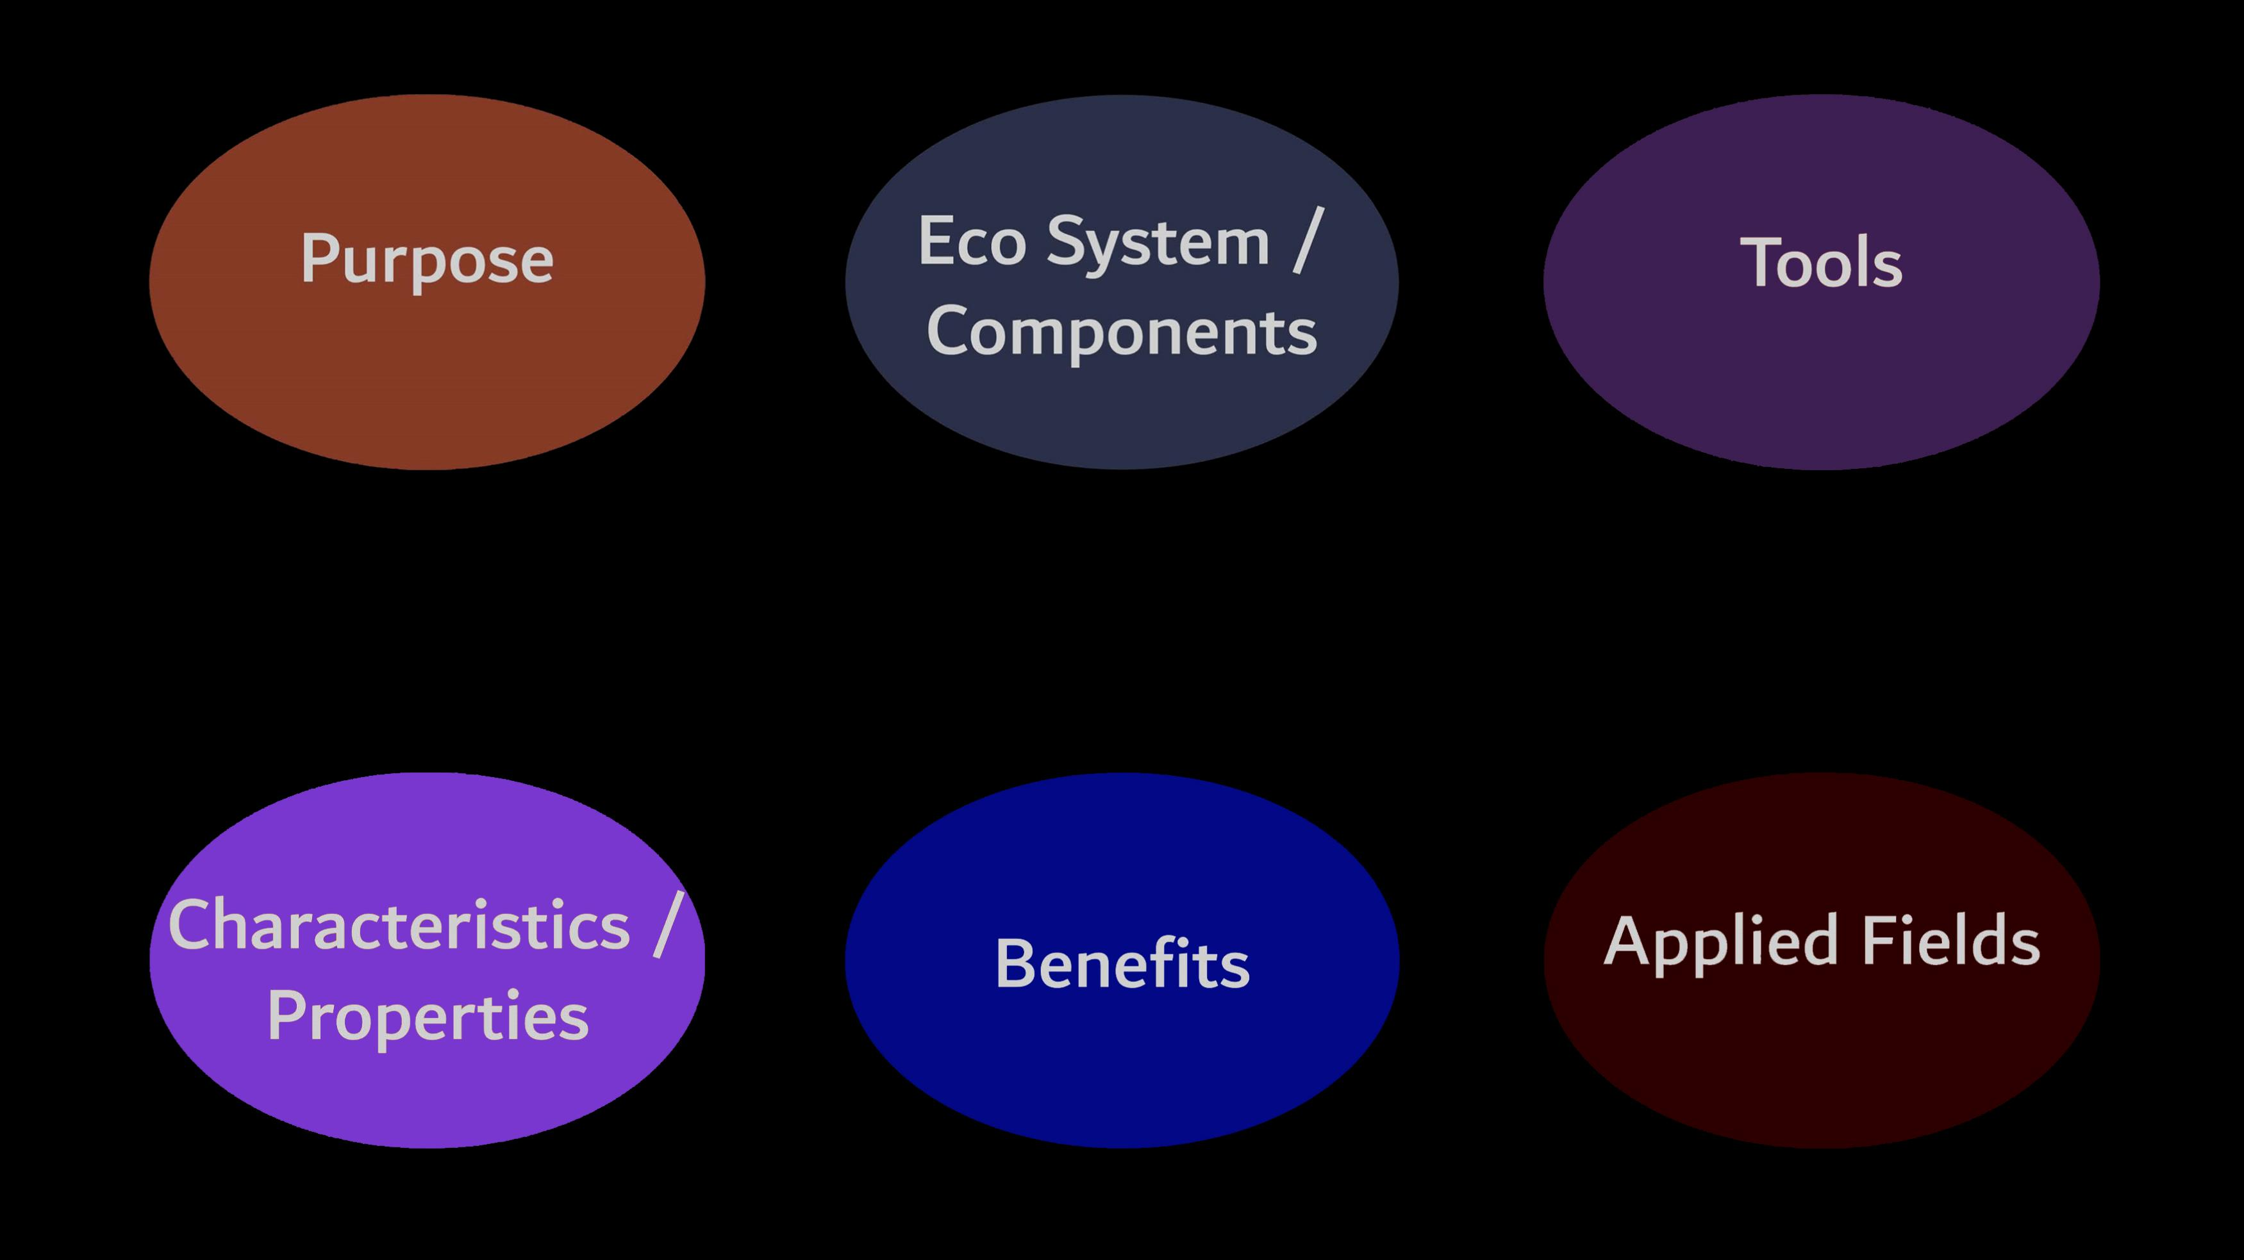

Slide 8
THANK YOU!!

